Slide 1
Development of Therapy Efficacy Model for Autism Spectrum Disorder
Batch No: 16
Team Members:
MEGA V M (211521244032)
GURU VARSHENI A (211521244015)
DHANUSHREE S (211521244011)
Guided By:
Dr. S. Hemalatha, Ph. D., D.Sc.
Professor and Head
Department of Computer Science and
Business Systems
Panimalar Institute of Technology

Slide 2
Abstract
Our project develops a Therapy Efficacy Model (TEM) using machine learning to predict the effectiveness of ASD interventions like ABA, Speech Therapy, and Occupational Therapy based on patient features
Utilize ensemble learning (Random Forest, SVM, XGBoost) for improved accuracy and feature importance analysis to identify key factors influencing therapy outcomes.
Implement explainable AI techniques (SHAP, LIME, LRP) to enhance transparency and trust in therapy recommendations for healthcare professionals and caregivers.
By incorporating these features, this study enables continuous monitoring of therapy progress, ensuring adaptive recommendations for personalized treatment plans.

Slide 3
Introduction
Autism Spectrum Disorder (ASD) is a complex and heterogeneous neurodevelopmental condition that affects millions of individuals worldwide. It is characterized by a wide range of symptoms, including difficulties in social communication, restricted interests, and repetitive behaviors. One of the major challenges in treating ASD is the high variability in how individuals respond to different therapies. To address these limitations, this project introduces a data-driven, intelligent Therapy Efficacy Model (TEM) for ASD, which leverages machine learning and deep learning techniques to optimize therapy recommendations. By combining ensemble models such as XGBoost, Support Vector Machine (SVM), and Random Forest, along with Long Short-Term Memory (LSTM) networks for time-series analysis, the system can analyse historical and current patient data to predict therapy outcomes. The goal is to enable adaptive and personalized therapy planning that evolves with the patient's progress.

Slide 4
Existing System
The current landscape of therapy efficacy assessment for Autism Spectrum Disorder (ASD) predominantly relies on subjective assessment, clinical judgment, and standardized behavioral assessment tools.
These traditional approaches, while widely used, exhibit significant limitations in terms of accuracy, adaptability, and personalization.
The existing system lacks personalization, resulting in a trial-and-error approach to therapy selection. It has limited integration of advanced computational techniques, offering minimal real-time tracking and adaptation.
The absence of explainability reduces trust in predictive models and their recommendations.

Slide 5
Proposed System
The TEM combines behavioral assessments, therapy response history, cognitive function data, and socio-environmental factors for a holistic therapy evaluation.
We utilize LSTM networks, attention mechanisms, autoencoders, and ensemble learning for therapy effectiveness prediction.
Implements SHAP, Layer-wise Relevance Propagation (LRP), and feature importance analysis to enhance clinical interpretability and transparency.
The goal is to continuously monitor therapy progress over time, dynamically adjusting recommendations using reinforcement learning.
Our system integrates Bayesian optimization, to ensure unbiased and secure predictions.0

Slide 6
Literary Survey
S. No | Year | Title | Author | Methodology | Merits | Demerits
1. | 2024 | Behavioral therapies for the treatment of autism spectrum disorder | Clara Lucato dos Santos Indyanara Inacio Barreto Ana Carolina Furian da Silva, Juliana Firmino Batista | Non-randomized clinical trials and observational studies. | Improved communication, Real time data | Limited Dataset, Lack of randomization
2. | 2024 | New advances in the diagnosis and treatment of autism spectrum disorders | Lei Qin, Haijiao Wang, Wenjing Ning, Mengmeng Cui | Reviews advancements and integrates neuroimaging, genetic screening. | Improved diagnostic accuracy, Real-time monitoring | High Cost, Standard treatment plans

Slide 7
S. No | Year | Title | Author | Methodology | Merits | Demerits
3. | 2023 | Multimodal Deep Learning in Early Autism Detection—Recent Advances and Challenges | Sheril Sophia, Jawahar Pradeepkandhasamy | Utilized deep learning techniques to analyse neuroimaging for ASD detection. | Improved early ASD detection accuracy | Computationally expensive, high hyperparameter tuning.
4. | 2021 | Developing and evaluating treatments for the challenges of autism | Leonard Abbeduto, Mustafa Sahin | explores and evaluates various treatment approaches for autism | comprehensive analysis of multiple therapeutic approaches | Dependent on observational studies so introduces bias

Slide 8
System Requirements
1. Hardware Requirements:
Processor: Intel i5/AMD Ryzen 5 or higher
RAM: 8 GB
Storage: 256 GB SSD
GPU : NVIDIA GPU with CUDA support
2. Software Requirements:
OS: Windows 10/11
IDE: Jupyter Notebook
ML: Random Forest, xgboost, Support Vector Machine
Visualization: matplotlib, seaborn
XAI: SHAP, LIME

Slide 9


















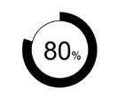
System Architecture
Autism Patients
Doctor
Server
TEM MODEL
Registration
Interacts with patient data
Performs Algorithms
Exlainable AI (XAI)
Data flow
Reviews Therapy Recommendation
Therapy booking
Notification System
ML Model Processing Layer
Patient Records
Predicts and explains therapy recommendation
Clinicial History
User Interface (UI)
Cognitive Scores
Database

Slide 10
Patient Module
Collects patient details such as clinical history, therapy duration, cognitive scores, and caregiver reports.
Monitors patient progress over time, allowing for adaptive treatment recommendations.
Provides an easy-to-use interface for patients and caregivers to view therapy progress and key insights
Allows caregivers and therapists to update patient responses and progress dynamically.
Feeds patient data into the machine learning model for therapy efficacy prediction and personalized recommendations.

Slide 11
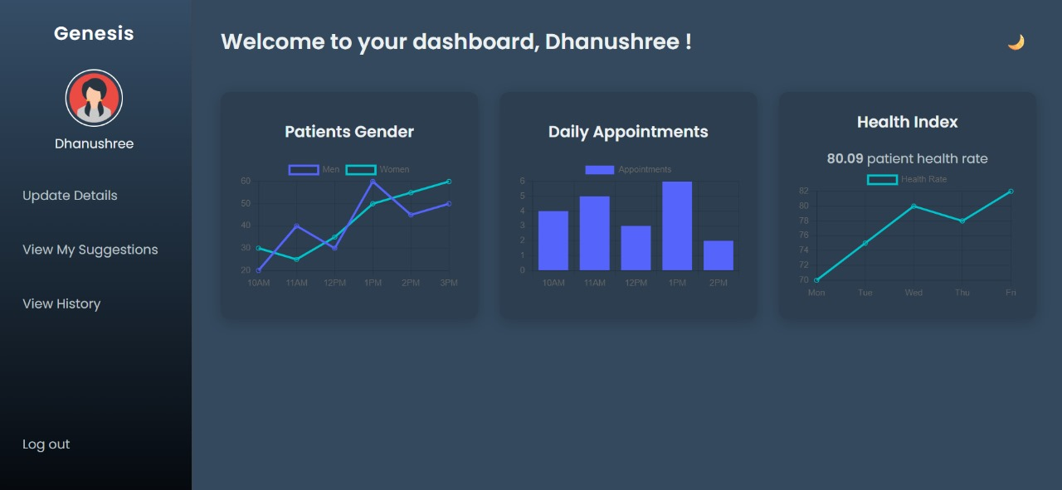

Slide 12
Doctor Module
Allows doctors to securely access and manage patient records and therapy progress.
Offers personalized treatment plans using data-driven therapy predictions..
Allows doctors to track patient improvements through interactive dashboards and analytics.
Assists doctors in making data-driven clinical decisions by providing insights from predictive models.
Facilitates direct communication between caregivers, and therapists to review progress and adjust treatment plans.

Slide 13
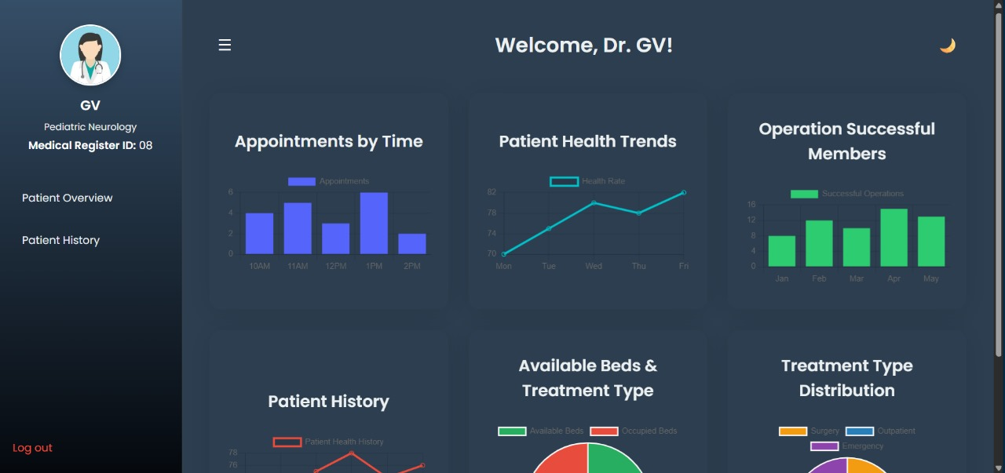

Slide 14
TEM Module
Designed to predict the effectiveness of different therapies for individuals with Autism Spectrum Disorder (ASD).
Collects and analyzes patient data to recommend the best treatment.
Algorithms like Random Forest, XGBoost, and Support Vector Machines are used for accurate predictions
Techniques like SHAP and Layer-wise Relevance Propagation (LRP) enhance transparency
TEM provides personalized, data-driven therapy recommendations for better ASD treatment outcomes.

Slide 15
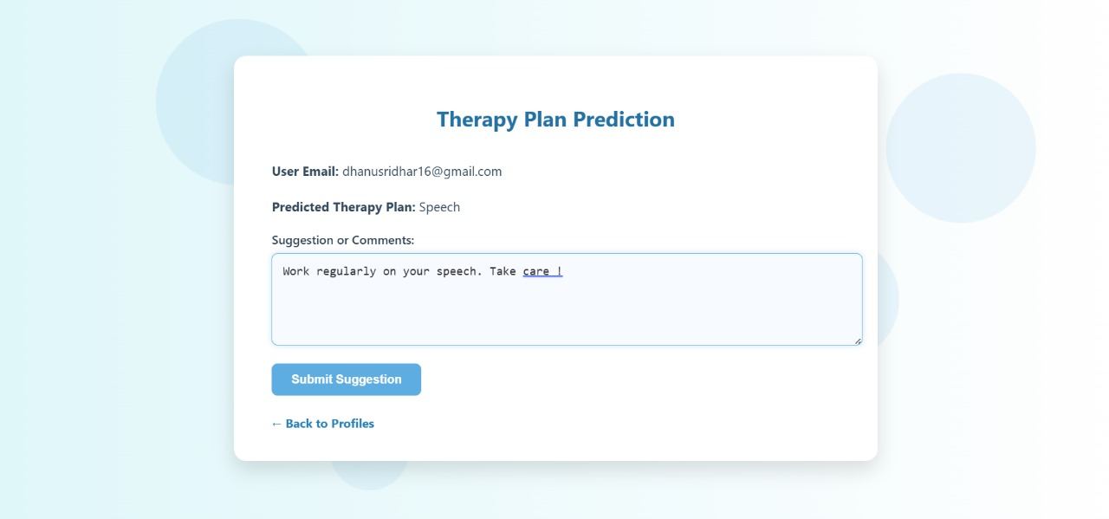

Slide 16
Server Module
Central component responsible for handling, processing, and managing all therapy-related data.
It securely stores patient records and therapy history while ensuring only authorized access
Analyzes patient data to give personalized therapy suggestions.
Ensures fast therapy suggestions using real-time patient data. Enhances decision-making with data-driven insights.
Security measures such as access control and encryption are implemented to protect sensitive information.

Slide 17
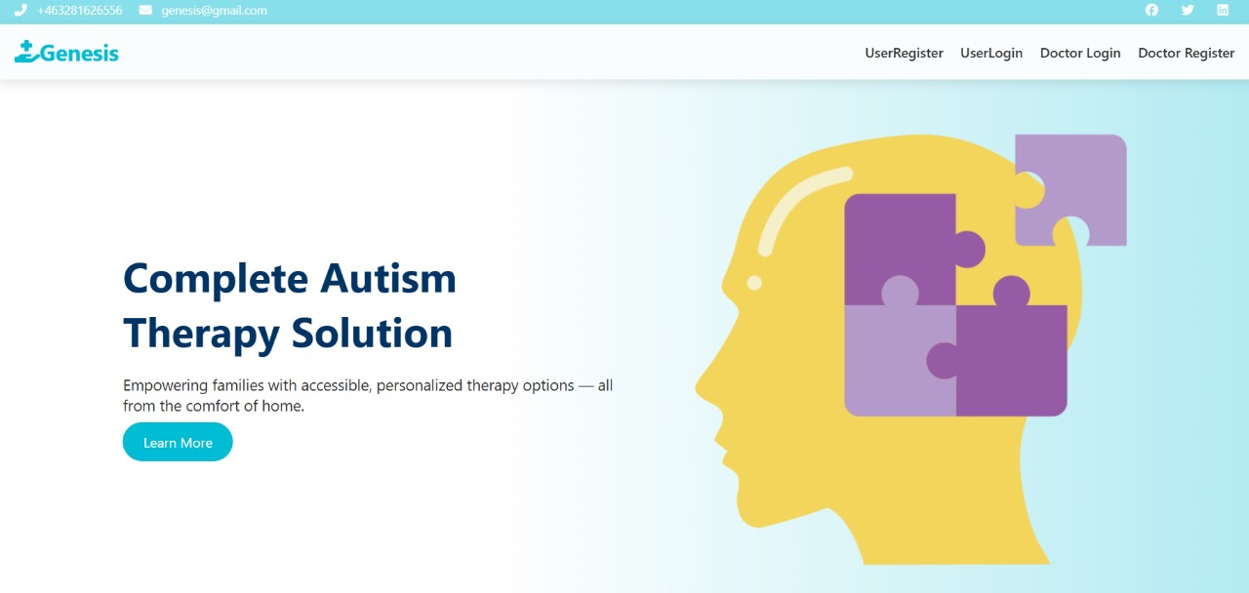
Output screenshot

Slide 18
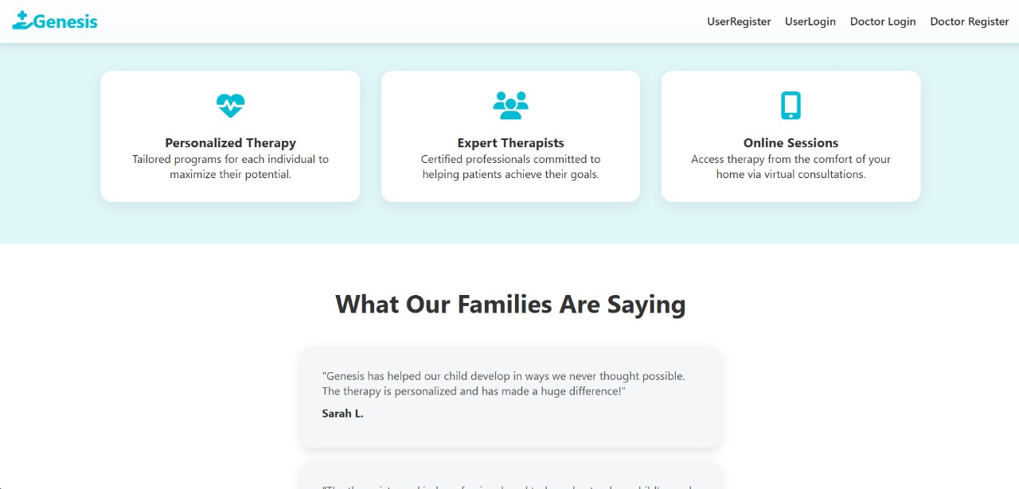
Output screenshot

Slide 19
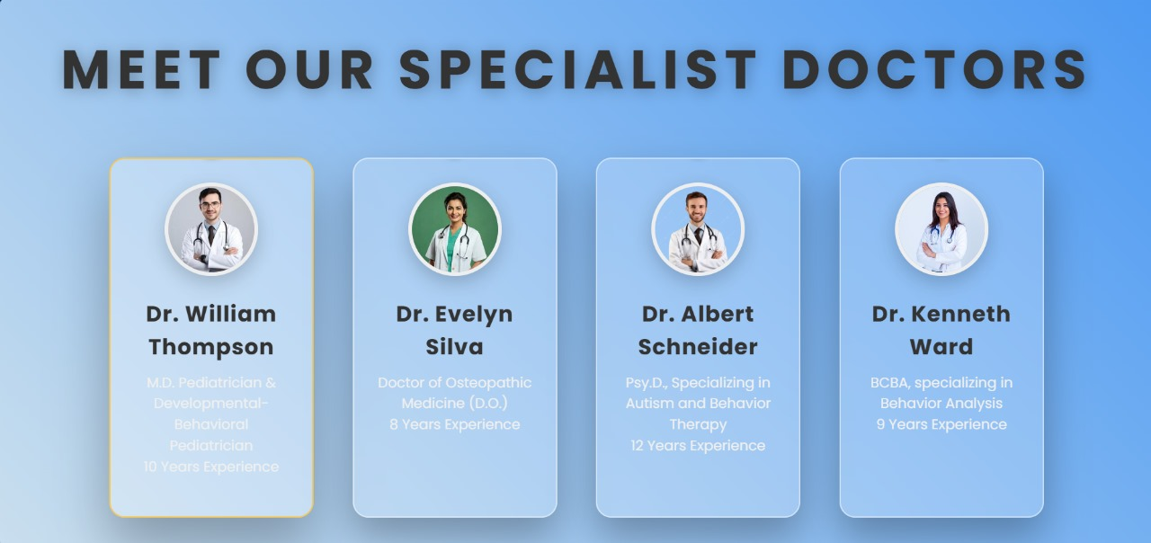
Output screenshot

Slide 20
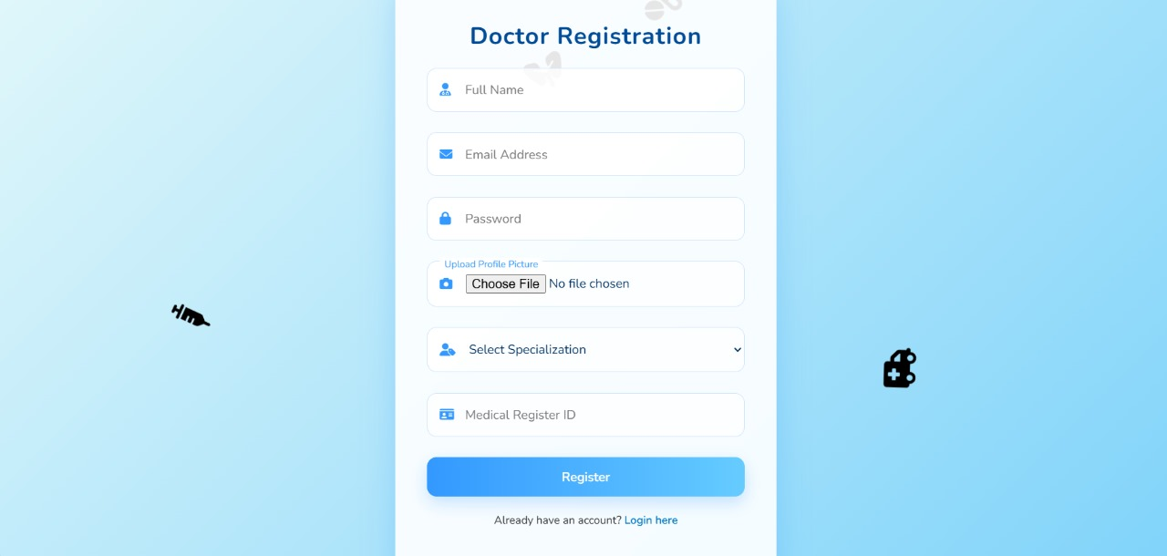
Output screenshot

Slide 21
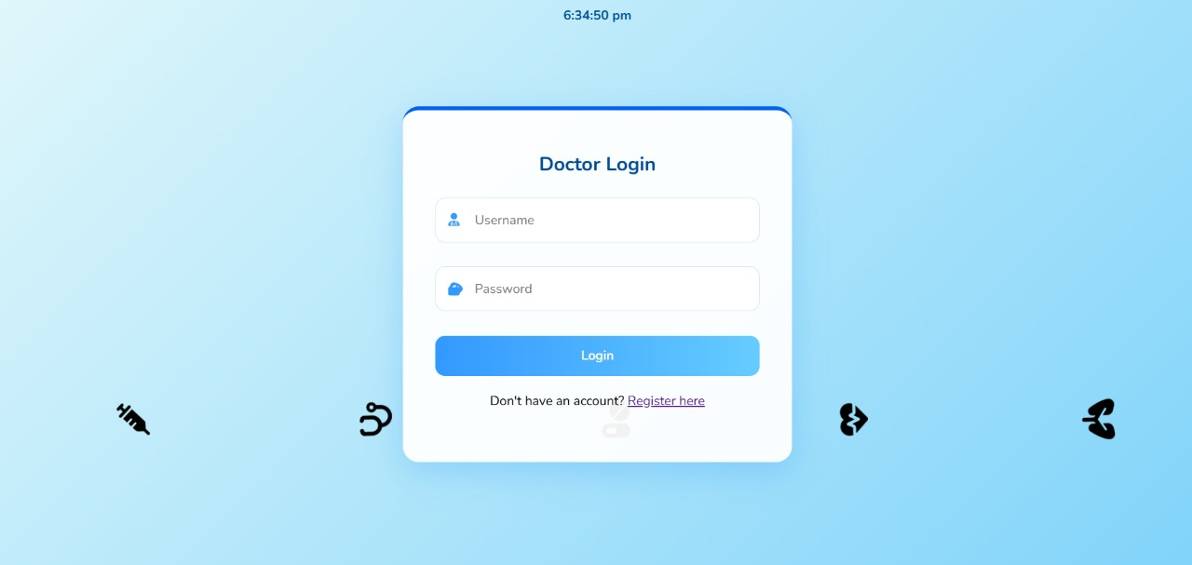
Output screenshot

Slide 22
Output screenshot

Slide 23
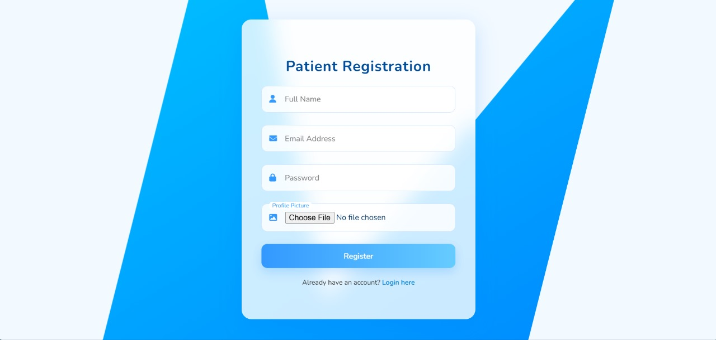
Output screenshot

Slide 24
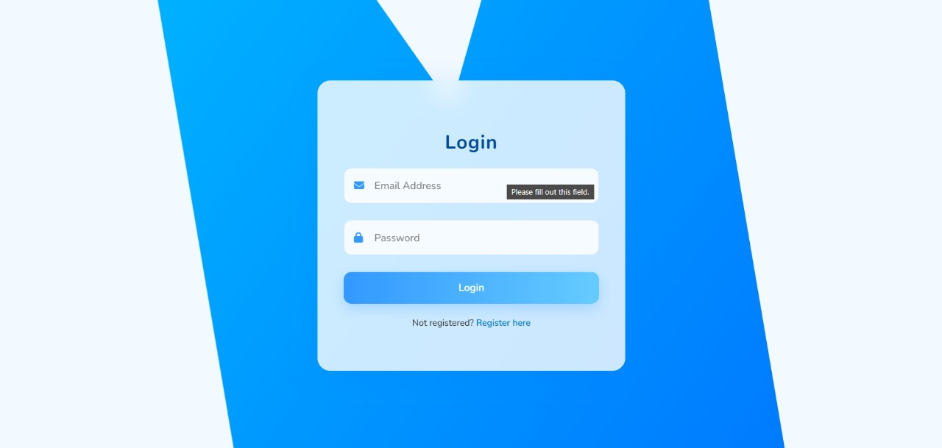
Output screenshot

Slide 25
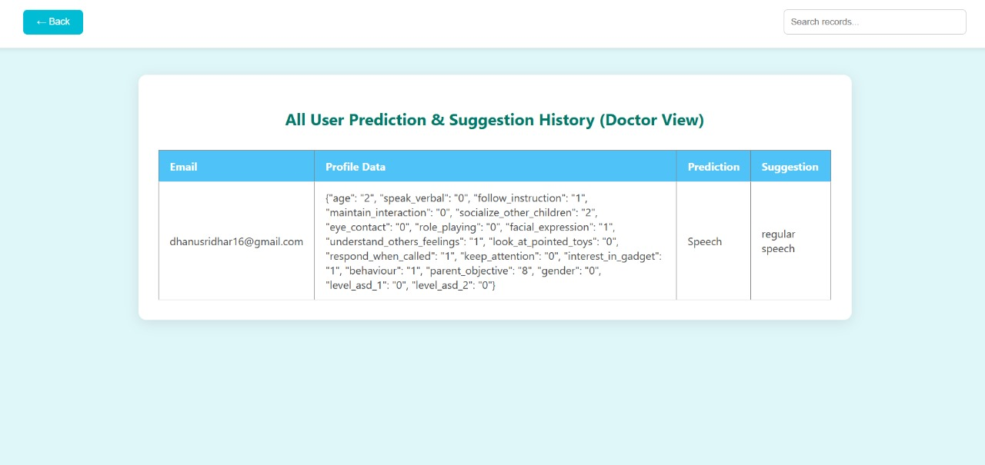
Output screenshot

Slide 26
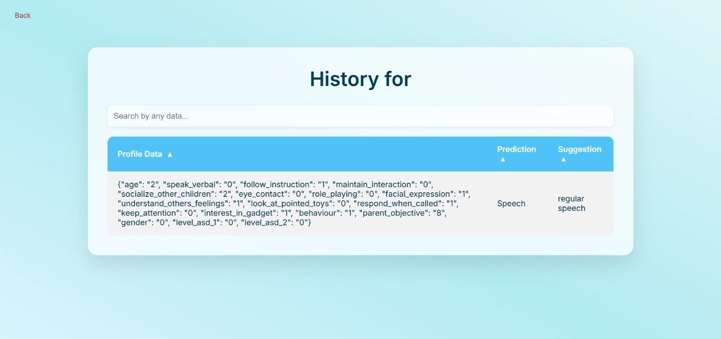
Output screenshot

Slide 27
Output screenshot

Slide 28
Conclusion
The Therapy Efficacy Model (TEM) developed using Random Forest, XGBoost, and SVM effectively predicts the outcomes of therapies like ABA, Speech Therapy, and Occupational Therapy for individuals with Autism Spectrum Disorder (ASD). The model identifies key factors such as early intervention age, therapy intensity, and baseline severity score, aiding personalized treatment recommendations. Its use of longitudinal analysis provides insights into therapy progression over time. By incorporating demographic and socioeconomic data, the model ensures broader applicability across diverse populations.

Slide 29
References
H. Ibrahim, A. K. Al-Talabani and C. K. Loo, "Utilizing Support Vector Machine to Help with Social Robot Therapy for Autism Spectrum Disorder," 2024 21st International Multi-Conference on Systems, Signals & Devices (SSD), pp. 562-567, Apr.–June 2024.
J R. Mishra, "Towards adaptive and personalized robotic therapy for children with Autism Spectrum Disorder," 2022 10th International Conference on Affective Computing and Intelligent Interaction Workshops and Demos, Oct,2022.
A. Sandygulova, A. Amirova, Z. Telisheva, A. Zhanatkyzy and N. Rakhymbayeva, "Individual Differences of Children with Autism in Robot-assisted Autism Therapy," 2022 17th ACM/IEEE International Conference on Human-Robot Interaction (HRI), Sept.2022
S. Dobesh, J. Albert, S. Ahmed and M. Sharmin, "Moving Towards an Accessible Approach to Music Therapy for Autistic People: A Systematic Review," 2023 IEEE 47th Annual Computers, Software, and Applications Conference (COMPSAC), Torino, Italy, 2023, pp. 472-480, Jun.2023
N. A. Zakaria, N. Syazwana Tajuddin, N. F. Sufea Mohd Supian, M. Dhiya’ul Hafidh Fatah Yasin, N. Lutfiani and N. S. Ahmad, "Systematic Mapping of Telehealth Features for Autism Spectrum Disorder Children: A Preliminary Results," 2024 3rd International Conference on Creative Communication and Innovative Technology (ICCIT), Tangerang, Indonesia, 2024, pp. 1-5, Aug.2024
S. Rachel, C. Buvana and S. Srinithi, "LEARNAUT - Upgraded Learning Environment and Web Application for Autism Environment using AR-VR," 2023 7th International Conference On Computing, Communication, Control And Automation (ICCUBEA), Pune, India, 2023, pp. 1-5,Aug.2023.
A. Al-Nafjan, H. Alarifi, N. Almuways, A. Alhameed and R. A. Hussain, "Artificial Virtual Reality Simulation Design for Children on Autism Spectrum Disorder," 2023 Congress in Computer Science, Computer Engineering, & Applied Computing (CSCE), Las Vegas, NV, USA, 2023, pp. 2052-2056, July.2023
S. Yu, "Analysis of VR Technology in Treating Autism," 2021 IEEE International Conference on Computer Science, Electronic Information Engineering and Intelligent Control Technology (CEI), Fuzhou, China, 2021, pp. 72-75, Sept.2021
M. Santiputri, E. B. Sembiring, N. Z. Janah and M. K. Mufida, "Abangmanis: Speech Theraphy for Autism Monitoring Mobile Application," 2019 2nd International Conference on Applied Engineering (ICAE), Batam, Indonesia, 2019, pp. 1-6, Oct.2020
C. Z. Wu, J. Q. Zheng, Z. F. He and S. C. Wang, "Application and Prospect of VR Technology in the Treatment of Autism," 2021 3rd International Conference on Machine Learning, Big Data and Business Intelligence (MLBDBI), Taiyuan, China, 2021, pp. 704-707, Dec,2021

Slide 30
Thank you

Slide 31
Queries :

